Slide 1
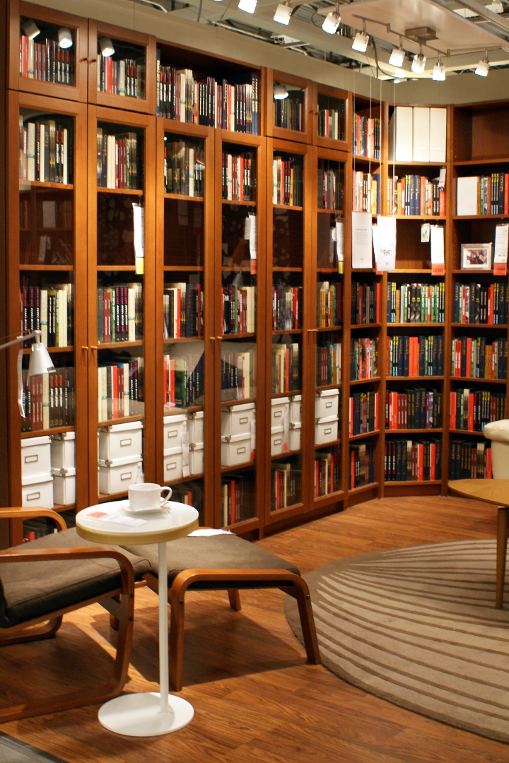
Online Library Management System (OLMS)
An innovative solution that revolutionizes the way library's function, providing convenient access to books and resources anytime, anywhere.

Slide 2

Problem Statement and Benefits
1
Problem: Inefficient processes
2
Benefits: Streamlined operations
Traditional library systems rely on manual record-keeping, resulting in time-consuming tasks like book checkouts, returns, and cataloging.
OLMS automates these tasks, improving efficiency and saving time for both librarians and users.
3
Benefits: Enhanced accessibility
Users can access the library's digital collection anytime, from any device with an internet connection.

Slide 3
Project Scope and Objectives
Scope of Initial Release
Scope of Subsequent Releases
User Registration and Authentication
Digital Resources Integration
Catalog Management
Mobile App
Borrowing and Returning Physical Resources
Recommendation System
Reservation System
Fine and Fee Management
User Profiles
Integration with Learning Management Systems (LMS)
Administrative Dashboard
Notifications
Accessibility Features
Reporting

Slide 4

Limitations and Exclusions
1
Limitations
2
Exclusions
Physical item management will still be necessary for certain resources, such as rare books or special collections.
Data entry for existing resources.
Training for library personnel
and users.
Integration with legacy systems.
User support after initial
deployment.
Legal compliance with copyright
and data privacy legislation.

Slide 5
Feasibility Analysis
Technical Feasibility
Financial Feasibility
Operational Feasibility
The required technologies and infrastructure are readily available and supported.
The investment required for OLMS development and maintenance is justifiable and within budget constraints.
The proposed system aligns well with the current library operations and can be easily incorporated.

Slide 6
Stakeholders
Librarians and Library Staff:
Students and Patrons:
System Administrators:
Library Visitors:
Catalog Management
User Support
Overdue Administration
User Registration
Resource Usage
Input
System Maintenance
User Account Management
System Updates
Security
Resource Search
Inquiries

Slide 7

Methodology: Plan-Driven (Waterfall)
The Waterfall model was chosen for the development of the Online Library Management System due to its suitability for projects with specific and stable requirements, regulatory compliance, linear development phases, limited user involvement, thorough documentation, reliability, long-term maintenance, and limited change scope.
1
Requirements Gathering
Engage with librarians and users to understand their needs and expectations.
2
System Design
Develop a user-friendly interface and integrate core library management functionalities.
3
Testing and Refinement
Conduct rigorous testing and incorporate feedback to ensure a stable and reliable system.

Slide 8

Risk Assessment and Mitigation Plan
1
Risk: Requirements Change
2
Risk: Technical Challenges
Mitigation: Collect and validate requirements. Create change control mechanism.
Mitigation: Conduct technical feasibility analysis. Allocate time and resources.
3
Risk: Data Security Breach
4
Risk: Staff Training
Mitigation: Implement strong security measures. Follow best practices.
Mitigation: Develop comprehensive staff training program. Start training early.

Slide 9
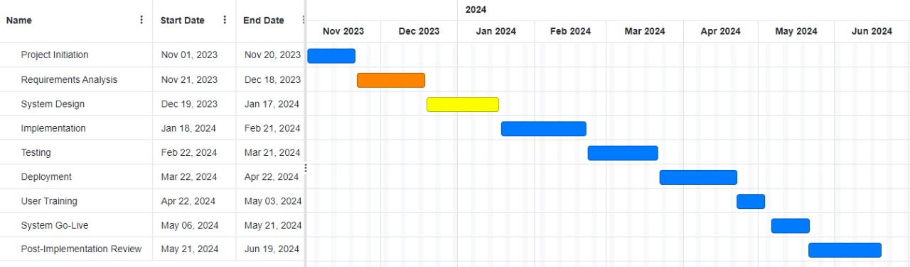
Timeline (Gantt Chart)

